Slide 1
AIDS IN PREGNANT WOMEN
Syeda Farwa Arshad
Salymbekov medical university​

Slide 2
ABSTRACT
OBJECTIVES :
Identify the etiology of the perinatal spread of HIV in pregnant women.
Summarize the evaluation of women with HIV.
Outline the management options available for HIV in pregnant women.
ETIOLOGY :
The transmission rate of HIV from mother to child (vertical transmission) is 20% to 25% for HIV-1 versus about 5% for HIV-2
CONCLUSION :
Dolutegravir-containing regimen (Anti-retroviral drugs) exhibited as a superior safety in the treatment.

Slide 3
Introduction
The study of HIV during pregnancy holds great significance because many women are first diagnosed with HIV during pregnancy.
Similarly, it is equally important in cases where one or both partners are HIV positive and wish to conceive.

Slide 4
EVALUATION
Gestational age estimation
CD4 cell counts
Viral load measurement
Drug resistance testing
ART toxicity monitoring
HLA-B*5701 testing
This should be done if abacavir-containing ART regimen is to be initiated

Slide 6
TOXOPLASMA AND CMV TESTING :
Unlike in HIV-negative women, serological testing for Toxoplasma gondii is recommended in HIV infected pregnant women. If T. gondii IgG is positive and CD4 count below 100/mL, then suppressive therapy is started.
VACCINATION ACCESSMENT :
In addition to the Tdap and influenza immunizations routinely given during pregnancy, HIV positive pregnant women should also receive pneumococcal and Hepatitis A & B (according to past infection status) vaccinations.

Slide 7
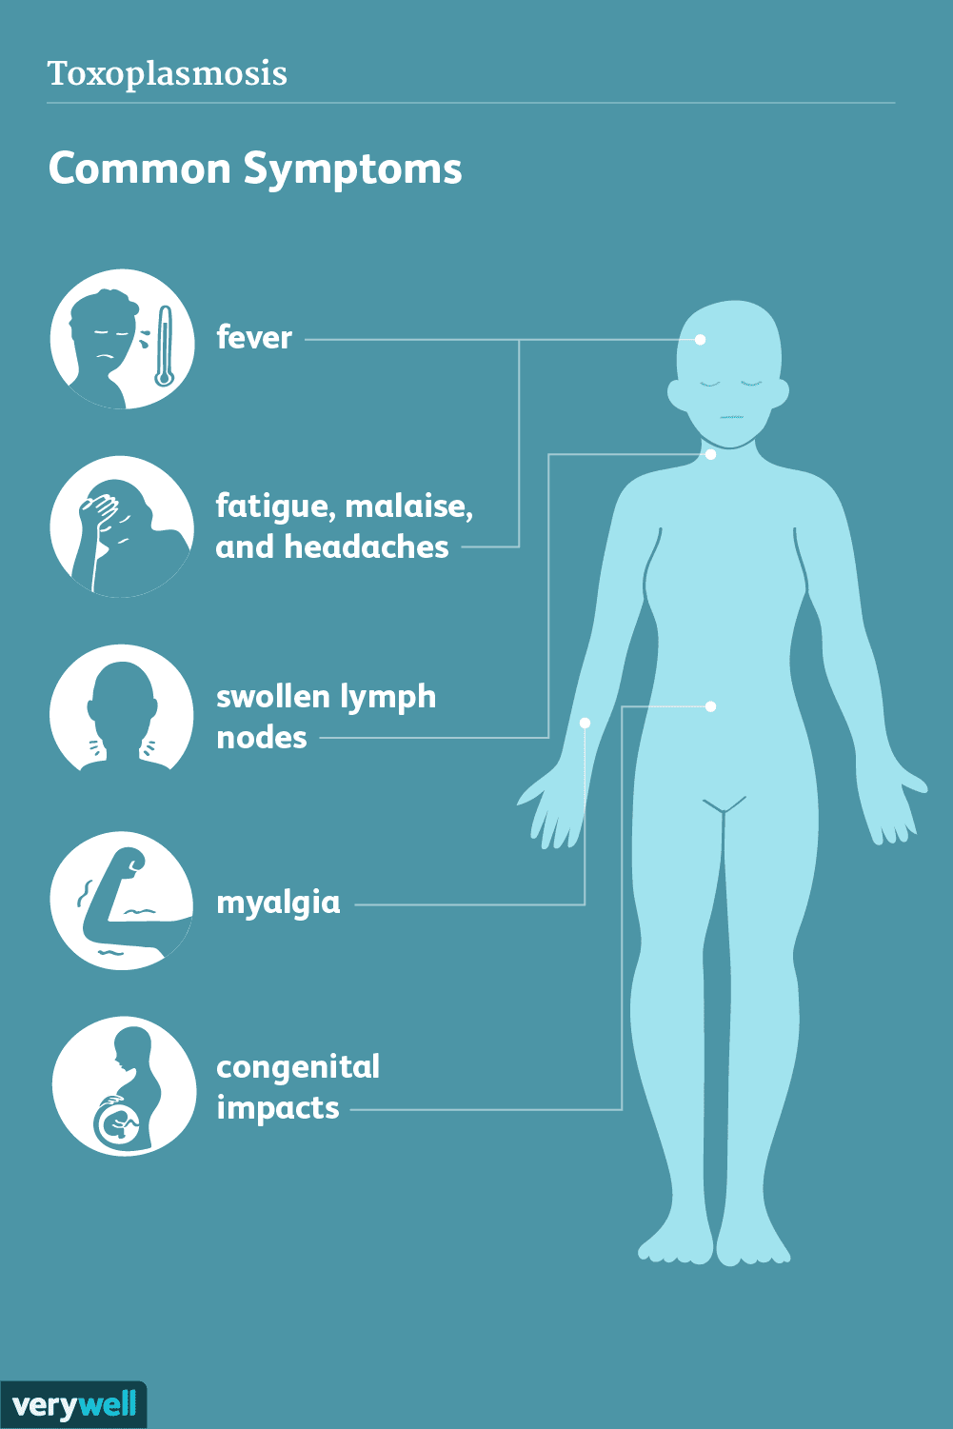
General Counsellingg:
This should include counseling about modifiable behaviors, which can lead to increased chances of perinatal HIV transmission, e.g., tobacco, alcohol, illicit drug use, unprotected sex in a non-monogamous relationship
Evaluation for opportunistic infections :
TMP-SMX is given to pregnant patients with CD4 cell count below 100/mL (Toxoplasma gondii and PCP) and 200/miroL (PCP) for prophylaxis against these opportunistic infections. This is done after discussing the possible teratogenicity risk of TMP-SMX with the patient.
Azithromycin is used as a prophylaxis against disseminated Mycobacterium avium complex infection in pregnant patients with CD4 cell count <50/mL.

Slide 8
IF I HAVE HIV, CAN I PASS IT ON TO MY BABY DURING PREGNANCY?
If you are pregnant and have HIV/AIDS , there is a risk of passing HIV to your baby.
In some cases, your doctor may suggest doing a Cesarean section to lower the risk during childbirth.
During pregnancy
During Breastfeeding
During childbirth, especially if it is vaginal childbirth.

Slide 9
Quarterly performance of KYRGYSZTAN over the year

Slide 10
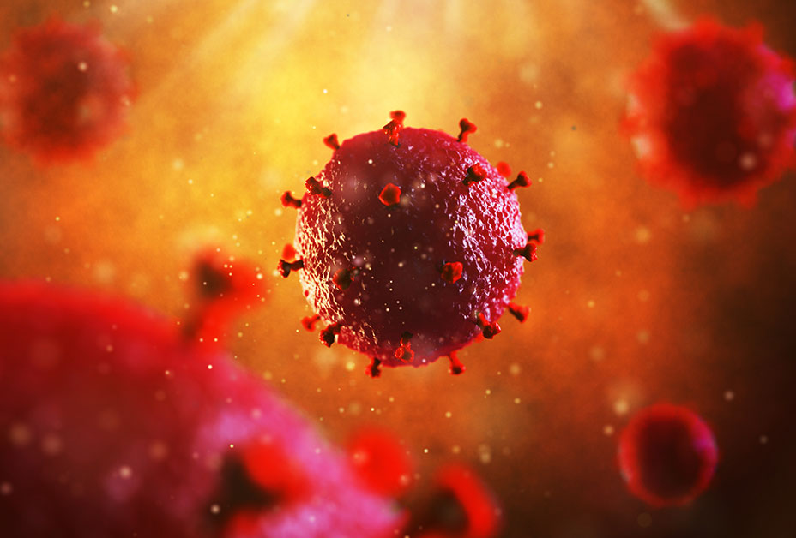
DIFFERENTIAL DIAGNOSIS
The differential diagnosis for acute HIV infection in pregnancy can include infectious mononucleosis (IM), syphilis, rubella, toxoplasmosis, viral hepatitis, disseminated gonococcal infection, or an autoimmune disease of new-onset.
PROGNOSIS
In the absence of any treatment, the risk of vertical transmission of HIV during pregnancy, delivery, or breastfeeding is as high as 25 to 30%. However, with rigorous testing, preconception counseling, good ART adherence, scheduled cesarean delivery, and infant prophylaxis, the rate of vertical transmission is as low as <1 to 2%

Slide 11
COMPLICATIONS
In untreated HIV positive women, the risk of developing opportunistic infections increases with the fall in CD4 cell counts. Opportunistic infections like CMV and toxoplasmosis can cross the placenta and infect the fetus leading to congenital abnormalities. Also, untreated HIV infection has high chances of being passed on to the newborn in utero, during delivery, or by breastfeeding.
ART regimens themselves are also associated with many complications. Dolutegravir is associated with NTDs, while protease inhibitors have been found to cause preterm birth. ZDV can cause hematological abnormalities in the infant . Similarly in utero exposure to HIV or ART drugs can also cause mitochondrial dysfunction later on in the child’s life

Slide 12
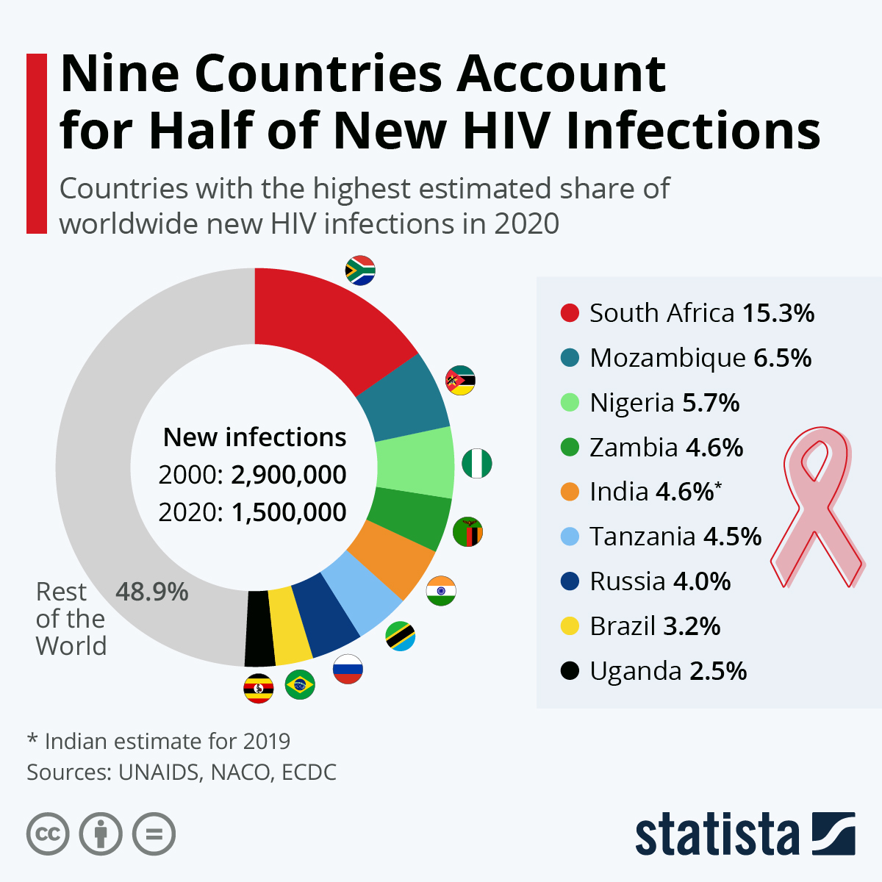

Slide 13
FEATURES OF THE COURSE OF PREGNANCY IN HIV-INFECTED WOMEN IN THE VOLOGDA REGION
Purpose of the study. Conduct a long-term analysis of the course of pregnancy in HIV-infected women.
Materials and research methods. The analysis was carried out on the basis of data obtained from the form of state statistical observation "History of childbirth", "Exchange card of the maternity hospital, maternity ward of the hospital,
Results. Pregnant HIV-infected women are most often 26-30 year old women who have a secondary education, are not employed in the economy, are not married, do not have bad habits and are sexually infected with the human immunodeficiency virus. By the age of sixteen, 50% of women in this group are already sexually active. Of the extragenital diseases during pregnancy, hepatitis B and C are most common (in 44% of those who gave birth). Primiparous women in the study group accounted for 35%, while 65% of those who gave birth were multiparous. The duration of infection with the human immunodeficiency virus for more than 5 years was noted in 32% of women, and 29.3% were identified as HIV-positive during pregnancy or childbirth. There is a positive trend in this indicator,
92.4% of women who gave birth received stage 1 chemoprophylaxis, including 17.2% of women who started taking antiretroviral drugs before pregnancy. There has been an increase in pre-pregnancy antiretroviral therapy coverage for women from 15% in 2011 to 35% in 2017.
When registering for pregnancy, in 71% of cases, the viral load exceeded 1000 copies / ml, and the level of CD4-lymphocytes in 37.5% of cases was less than 350 cells / μl. However, before delivery, the viral load level dropped to undetectable levels in 76.6% of women, and the number of women with a CD4-lymphocyte level of less than 350 cells/µl decreased to 24.8%. Compared to all women who delivered a pregnancy between 2011 and 2017, women with HIV infection were 2 times more likely to have anemia (29% and 59%, respectively) and urinary tract infections (19% and 46%, respectively).

Slide 14
CONCLUSION
Increasing the coverage of screening for HIV infection, active involvement of lawyers, interaction with medical organizations of primary health care, as well as with medical organizations that provide assistance to women during pregnancy, will allow detecting HIV infection in the early stages before pregnancy, prescribing highly active antiretroviral therapy for women planning pregnancy, to detect HIV infection earlier in pregnancy and to form adherence to dispensary observation and HEART.

Slide 15
TREATMENT

Slide 16
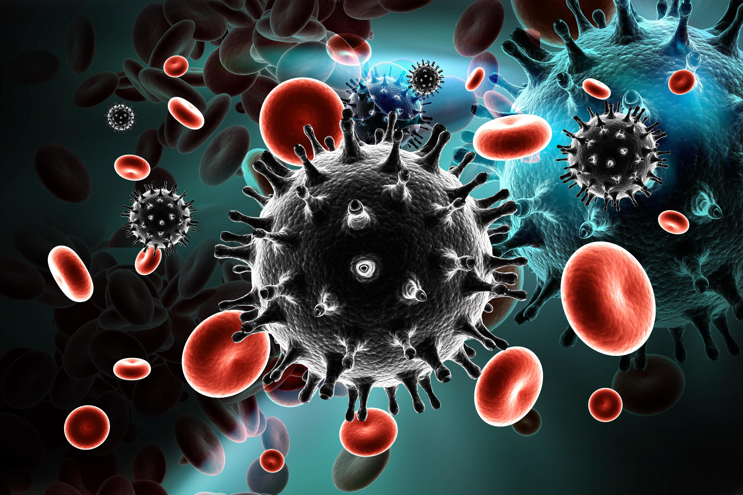
DOLUTEGRAVIR-CONTAINING REGIMEN EXHIBITED SUPERIOR SAFETY PROFILE IN LARGE (ANTI-RETROVIRAL THERAPY
The antiretroviral drugs dolutegravir and emtricitabine/tenofovir alafenamide fumarate (DTG+FTC/TAF) may comprise the safest and most effective HIV treatment regimen currently available during pregnancy, researchers announced today.
24% of women taking DTG+FTC/TAF had an adverse pregnancy outcome compared with 33% of women taking DTG+FTC/TDF or EFV/FTC/TDF.

Slide 17
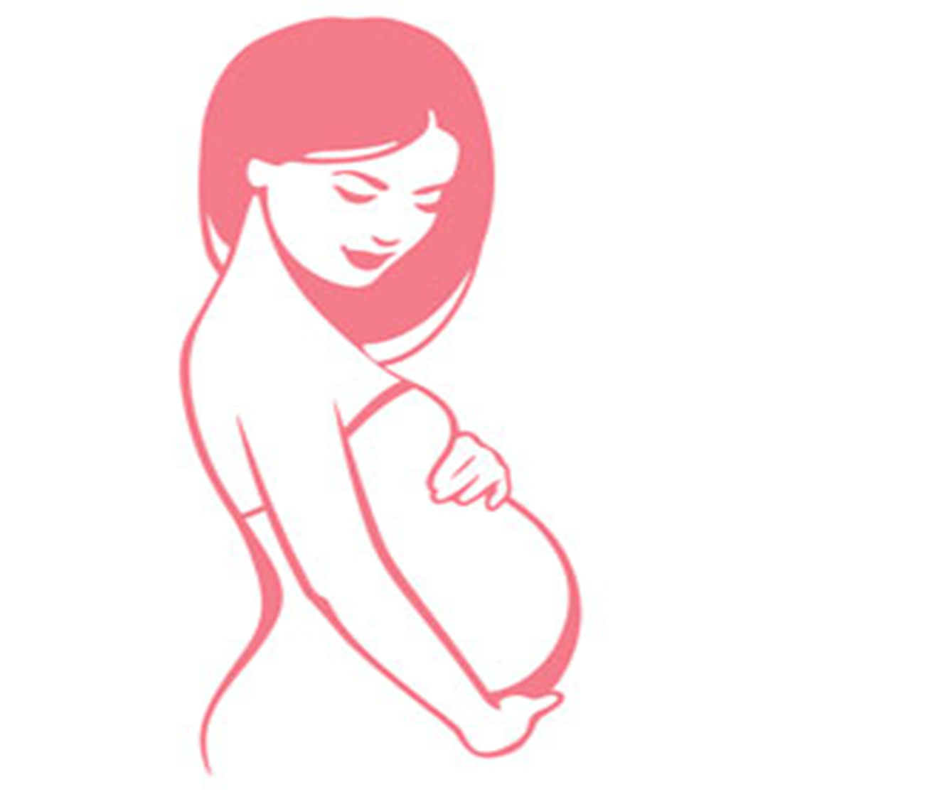
CONCLUSION
F
ART Monitoring and Dolutegravir can be very effective in the treatment of HIV in pregnant women.

Slide 18
Education, awareness and prevention are the key, but stigmatization and exclusion from family is what makes people suffer most
“
”
Ralph Fiennes

Slide 19
Thank you

