Slide 1
“Salymbekov university” Institution
International faculty of medicine
Prevention of SARS-CoV-2 Infection
Vaccination. Types of vaccine.
Advantages and disadvantages
Butt Sohira Naz, GM 7-20
Teacher : PEREGUDOVA O.V

Slide 2
Prevention of SARS-CoV-2 Infection
Vaccination Types of vaccine.
Advantages and disadvantages

Slide 3
The main goal of the report
To show variety of types of COVID-19 vaccines, mechanisms of its action.
Vaccination remains the most effective way to prevent SARS-CoV-2 infection and should be considered the first line of prevention.

Slide 4
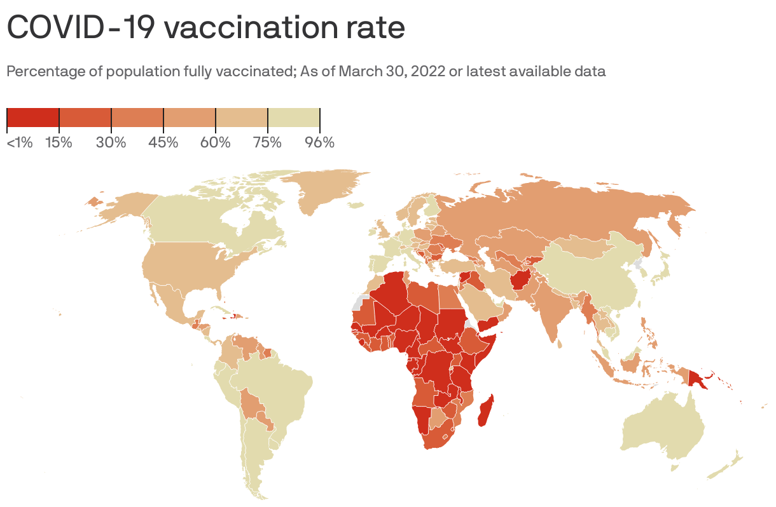
COVID-19 CORONAVIRUS PANDEMIC
23.10.2022
Coronavirus Cases: 632,788,026
Deaths: 6,582,514
Recovered: 611,619,170
Vaccinated:
68.4% of the world population has received at
least one dose of a COVID-19 vaccine.
12.86 billion doses have been administered
globally, and 2.69 million are now administered each day.
23.3% of people in low-income countries have
received at least one dose.

Slide 5
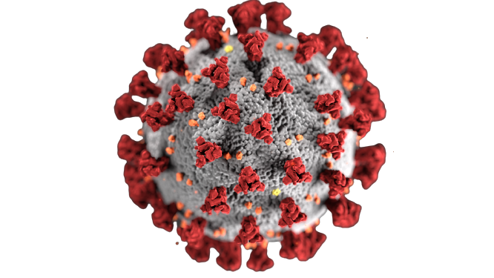
COVID-19
SARS-CoV-2
2019-nCov
NCoV-19

Slide 6
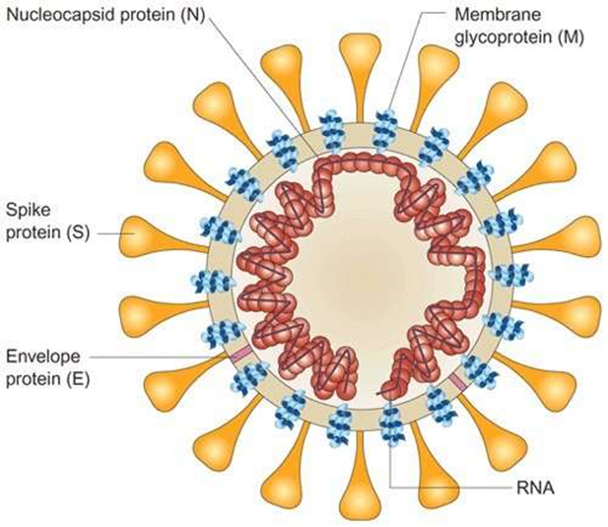
Coronavirus Structure
•Medium-sized virus size, but largest mRNA genome
•Enveloped +ve stranded RNA
•mRNA encased in nucleocapsid
•Lipid Bilayer – Soap works to disrupt this!
•Corona = Crowns for Spikes
•Glycoprotein Spike (S) Peptomer
•Spikes allow it to attach to human cell receptors in upper or lower airway

Slide 7
Coronavirus Genome
•Encodes four or five structural proteins:
–S – spikes on the outside; mediates receptor binding
–M – membrane protein; assists viral assembly
–N – nucleocapsid protein; regulation of viral RNA synthesis, may interact with M protein during virus budding
–E – small envelope protein; function necessary but not fully understood
–HE – hemagglutinin-esterase glycoprotein in Beta coronavirus OC43 and HKU1 only; enhances uptake into mucosal cells

Slide 8
Coronavirus has a nonsegmented single stranded, positive – polarity RNA genome.
It is enveloped virus with a helical nucleocapsid.
There is no viral polymerase. In electronic microscope, prominent club-shaped spikes in the form of corona (halo) can be seen.
The receptor for the SARS coronavirus on the surface of cells is Angiotensin Converting Enzyme 2(ACE - 2), which is most abundant in type II alveolar cell of the lungs.
The virus also affects gastrointestinal organs as ACE2 is abundantly expressed in the glandular cells of gastric, duodenal and rectal epithelium as well as endothelial cells and enterocytes of the small intestine

Slide 9
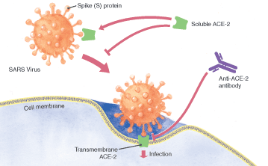
Novel CoV attachment
ACE-2 Receptors
Type 2 alveolar cells - highest
Bronchial epithelia
Tongue > buccal epithelia
Upper Intestinal epithelia
Myocardial cells
Kidney proximal tubule cells
Bladder urothelial cells
SARS-CoV-2 binds to ACE-2 Receptor 10-20x more strongly than SARS-CoV
Question of ADEs (Antibody Dependent Enhancement)
Antibodies can create a backdoor enhancement for viral replication
Implications on viral replication and vaccine development safety

Slide 10
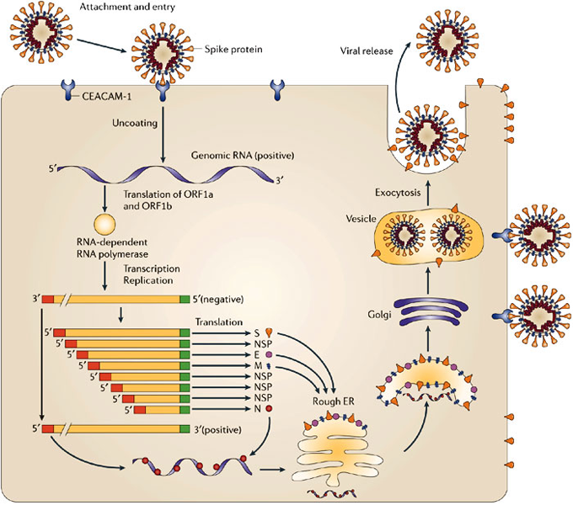
Coronavirus replication

Slide 11
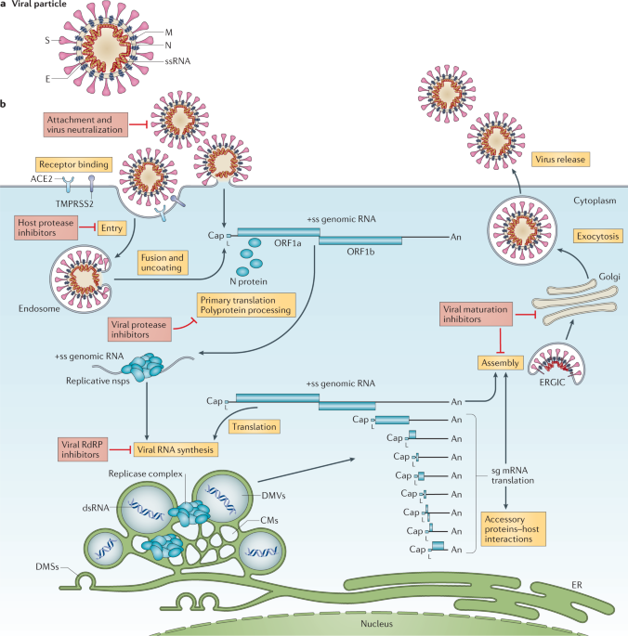

Slide 12
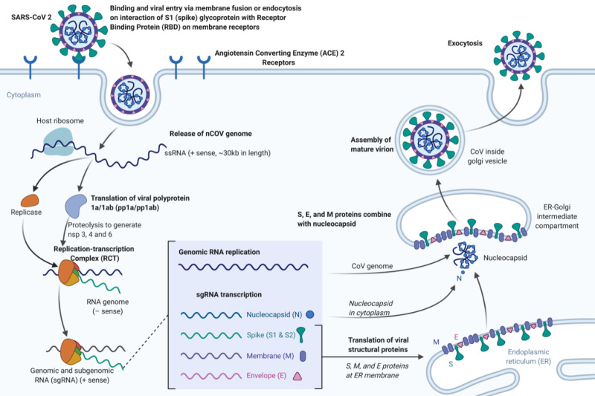

Slide 13
Coronavirus replication
Coronavirus adsorbs to cells via its surface spikes, after which it enters the cytoplasm of target cells, where it is uncoated. The positive – strand genome is translated into 2 large polypeptides, which are self-cleaved by the virus-encoded protease.
Two of these peptides aggregate to form the RNA polymerase that replicates the genome. In addition, mRNAs are synthesized and then translated into the structural proteins. The virus is assembled and
obtains its envelope from the endoplasmic reticulum, not from plasma membrane.
Replication occurs in cytoplasm

Slide 14
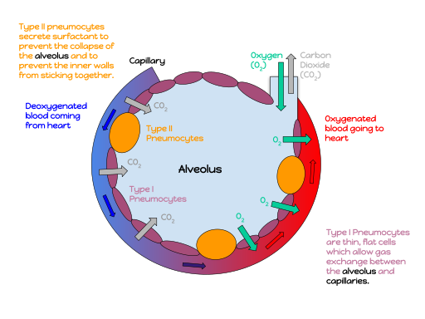

Slide 15
Pathophysiology
COVID‑19 can affect the upper respiratory tract (sinuses, nose, and throat) and the lower respiratory tract (windpipe and lungs). The lungs are the organs most affected by COVID‑19 because the virus accesses host cells via the enzyme angiotensin-converting enzyme 2 (ACE2), which is most abundant in type II alveolar cells of lungs. The virus uses a special surface glycoprotein called a "spike" (peplomer) to connect to ACE2 and enter the host cell. The density of ACE2 in each tissue correlates with the severity of the disease in that tissue and some have suggested decreasing ACE2 activity might be protective, though another view is that increasing ACE2 using angiotensin II receptor blocker medications could be protective. As the alveolar disease progresses, respiratory failure might develop and death may follow.

Slide 16
The virus can cause acute myocardial injury and chronic damage to the cardiovascular system. An acute cardiac injury was found in 12% of infected people admitted to the hospital in Wuhan, China, and is more frequent in severe disease.Rates of cardiovascular symptoms are high, owing to the systemic inflammatory response and immune system disorders during disease progression, but acute myocardial injuries may also be related to ACE2 receptors in the heart. ACE2 receptors are highly expressed in the heart and are involved in heart function.
A high incidence of thrombosis (31%) and venous thromboembolia(25%) have been found in ICU *Intensive care unit* patients with COVID‑19 infections, and may be related to poor prognosis.

Slide 17
Blood vessel dysfunction and clot formation (as suggested by high D-dimer levels) are thought to play a significant role in mortality, incidences of clots leading to pulmonary embolisms, and ischaemic events within the brain have been noted as complications leading to death in patients infected with SARS-CoV-2.
Infection appears to set off a chain of vasoconstrictive responses within the body, constriction of blood vessels within the pulmonary circulation has also been posited as a mechanism in which oxygenation decreases alongside the presentation of viral pneumonia.

Slide 18
Another common cause of death is complications related to the kidneys. Early reports show that up to 30% of hospitalized patients both in China and in New York have experienced some injury to their kidneys, including some persons with no previous kidney problems.
Autopsies of people who died of COVID‑19 have found diffuse alveolar damage (DAD), and lymphocyte-containing inflammatory infiltrates within the lung.

Slide 19
SARS-CoV-2 may also cause respiratory failure through affecting the brainstem as other coronaviruses have been found to invade the central nervous system. While virus has been detected in cerebrospinal fluid of autopsies, the exact mechanism by which it invades the CNS remains unclear and may first involve invasion of peripheral nerves given the low levels of ACE2 in the brain.
The virus also affects gastrointestinal organs as ACE2 is abundantly expressed in the glandular cells of gastric, duodenal and rectal epithelium as well as endothelial cells and enterocytes of the small intestine.

Slide 20
Immunopathology
Although SARS-CoV-2 has a tropism for ACE2-expressing epithelial cells of the respiratory tract, patients with severe COVID‑19 have symptoms of systemic hyperinflammation. Clinical laboratory findings of elevated IL-2,IL-7,IL-6, granulocyte-macrophage colony-stimulating factor (GM-CSF), interferon-γ inducible protein 10 (IP-10), monocyte chemoattractant protein 1 (MCP-1), macrophage inflammatory protein 1-α (MIP-1α), and tumour necrosis factor-α (TNF-α) indicative of cytokine release syndrome (CRS) suggest an underlying immunopathology.

Slide 21
Additionally, people with COVID‑19 and acute respiratory distress syndrome (ARDS) have classical serum biomarkers of CRS, including elevated C-reactive protein (CRP), lactate dehydrogenase(LDH), D-dimer, and ferritin.
Systemic inflammation results in vasodilation, allowing inflammatory lymphocytic and monocytic infiltration of the lung and the heart. In particular, pathogenic GM-CSF-secreting T-cells were shown to correlate with the recruitment of inflammatory IL-6-secreting monocytes and severe lung pathology in COVID‑19 patients. Lymphocytic infiltrates have also been reported at autopsy

Slide 22
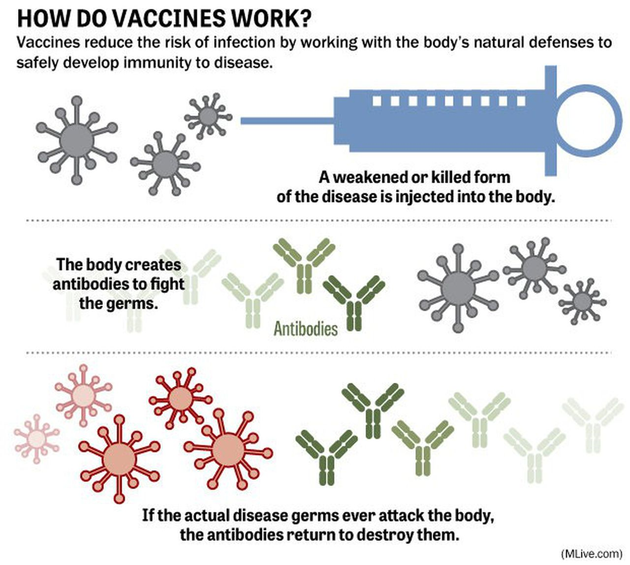

Slide 23
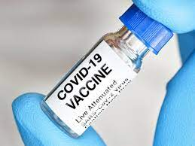
Vaccine types
Different technology platforms are under research and development to create an effective vaccine against COVID‑19. Most of the platforms of vaccine candidates in clinical trials are focused on the coronavirus spike protein and its variants as the primary antigen of COVID‑19 infection, since the S protein triggers immune responses.
Platforms being developed in 2020-2022 involved
•nucleic acid technologies (nucleoside-modified messenger RNA and DNA )
•inactivated viruses
•live attenuated viruses
•non-replicating viral vectors
•recombinant proteins
• peptides

Slide 24
COVID-19 vaccine ingredients are considered safe for most people. Nearly all of the ingredients in COVID-19 vaccines are ingredients found in many foods—fats, sugar, and salts.
None of the COVID-19 vaccines affect or interact with our DNA and the following are not included in the vaccines:
No preservatives such as thimerosal or mercury or any other preservatives.
No antibiotics such as sulfonamide or any other antibiotics.
No medicines or therapeutics such as ivermectin or any other medications.
No tissues such as aborted fetal cells, gelatin, or any materials from any animal.
No food proteins such as eggs or egg products, gluten, peanuts, tree nuts, nut products, or any nut byproducts.
No metals such as iron, nickel, cobalt, titanium, or rare earth alloys. They also do not have any manufactured products like microelectronics, electrodes, carbon nanotubes or other nanostructures, or nanowire semiconductors.

Slide 25
RNA vaccines
Several COVID-19 vaccines, including the PfizerBioNTech and Moderna vaccines, have been developed to use RNA to stimulate an immune response.
When introduced into human tissue, the RNA contained in the vaccine acts as messenger RNA (mRNA) to cause cells to build the SARS-CoV-2 spike protein. This teaches the body how to identify and destroy the corresponding pathogen. RNA vaccines often, but not always, use nucleoside-modified messenger RNA. The delivery of mRNA is achieved by a coformulation of the molecule into lipid nanoparticles which protect the RNA strands and help their absorption into the cells.
RNA vaccines were the first COVID‑19 vaccines to be authorized in the United Kingdom, the United States and the European Union

Slide 26
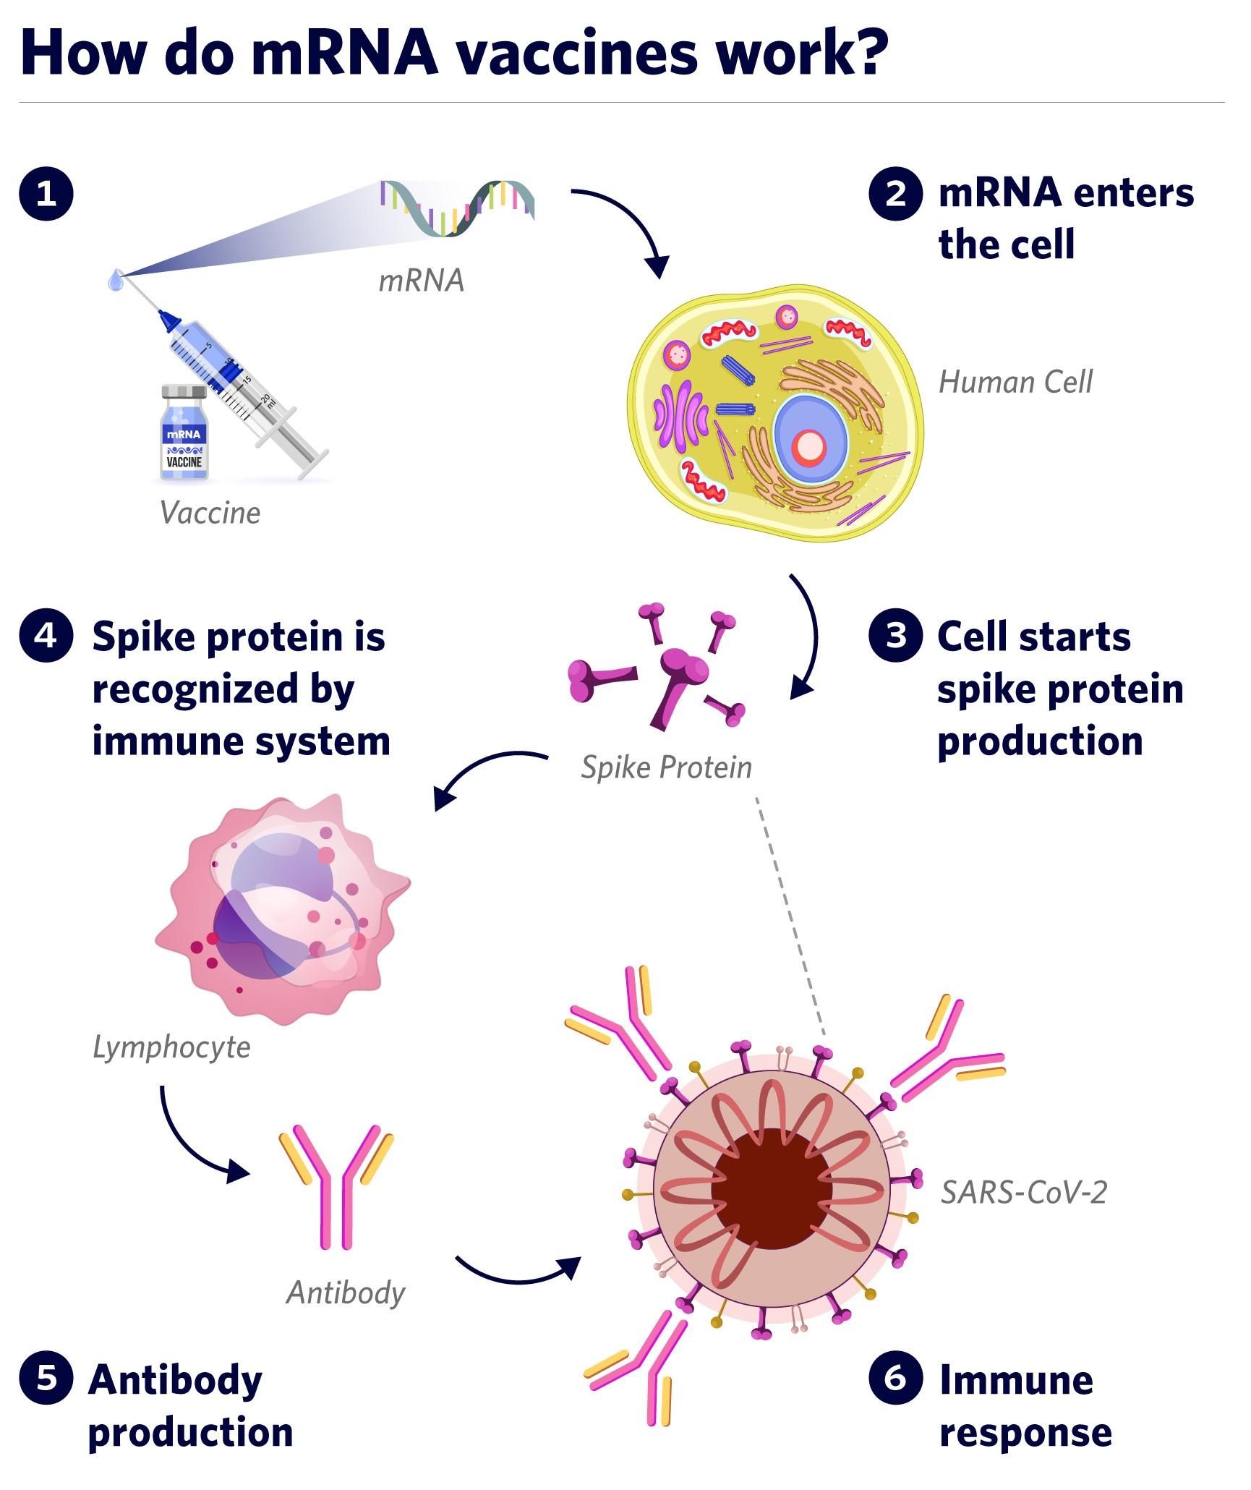

Slide 27
Adenovirus vector vaccines
These vaccines are examples of non-replicating viral vector vaccines using an adenovirus shell containing DNA that encodes a SARS‑CoV‑2 protein. The viral vector-based vaccines against COVID‑19 are non-replicating, meaning that they do not make new virus particles, but rather produce only the antigen which elicits a systemic immune response.
Authorized vaccines of this type are
the Oxford–Astra Zeneca COVID-19 vaccine ( not currently available)
the Janssen's vaccine (not currently available)
the Sputnik V COVID-19 vaccine (not approved by WHO)

Slide 28
Sputnik V:
uses Ad26 for its first dose, which is the same as Janssen's only dose, and Ad5 for the second dose. On 11 August 2021, the developers of Sputnik V proposed, in view of the Delta case surge that Pfizer test the Ad26 component (termed its ‘Light’ version) as a booster shot:
the Oxford–AstraZeneca COVID-19 vaccine
Developed in the United Kingdom by Oxford University and British-Swedish company AstraZeneca, using as a vector the modified chimpanzee adenovirus ChAdOx.
Researchers from the University of Oxford have reported new findings of an intranasally-administered vaccine against COVID-19. The study was performed at the University in collaboration with AstraZeneca and used the same vaccine based on the ChAdOx1 adenovirus vector, as is already licensed for use by injection.

Slide 29
Viral vector vaccines (mechanism of action)

Slide 30
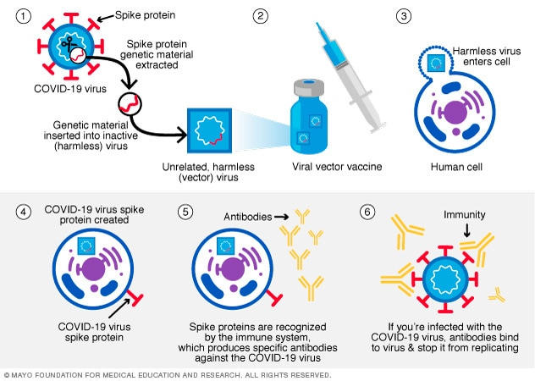

Slide 31
Inactivated virus vaccines
Inactivated vaccines consist of virus particles that have been grown in culture and then are killed using a method such as heat or formaldehyde to lose disease producing capacity, while still stimulating an immune response.
Authorized vaccines of this type are the Chinese
CoronaVac,
The Sinopharm BIBP COVID-19 vaccine, also known as BBIBP-CorV, the Sinopharm COVID-19 vaccine, or BIBP vaccine
the Indian Covaxin;
the Kazakhstani vaccine QazVac

Slide 32
Protein subunit vaccines
Novavax protein subunit COVID-19 vaccine
Protein subunit vaccines contain pieces (proteins) of the virus that causes COVID-19. The virus pieces are the spike protein.
The Novavax COVID-19 vaccine contains another ingredient called an adjuvant. It helps the immune system respond to that spike protein. After learning how to respond to the spike protein, the immune system will be able to respond quickly to the actual virus spike protein and protect you against COVID-19.

Slide 33
Live-attenuated vaccine
COVI-VAC is a single-dose intranasal live-attenuated vaccine against SARS-CoV-2 produced by the United Kingdom (UK)'s Codagenix and Serum Institute of India. Codagenix has introduced 283 silent mutations into the gene encoding the viral spike protein. As a live-attenuated vaccine, COVI-VAC presumably produces immunity against all SARS-CoV-2 proteins, not just the spike surface protein, protecting a range of SARS-CoV2 strains. Live-attenuated vaccines such as COVI-VAC deliver a strong immune response and are associated with the long-lasting cellular immunity.

Slide 34
Vaccines (except intranasal) are given as a shot in the muscle of the upper arm or in the thigh of a young child. COVID-19 vaccine ingredients are considered safe for most people.
After the body produces an immune response, it discards all of the vaccine ingredients, just as it would discard any substance that cells no longer need. This process is a part of normal body functioning.
Side Effects
Side effects that happen within 7 days of getting vaccinated are common but are mostly mild. Sometimes they may affect a person’s ability to do daily activities.
Side effects throughout the body (such as fever, chills, tiredness, and headache) are more common after the second dose of a Pfizer-BioNTech, Moderna, or Novavax COVID-19 vaccine.

Slide 35
Adverse Effects
Severe allergic reactions to vaccines are rare but can happen.
There is a rare risk of myocarditis and pericarditis associated with mRNA COVID-19 vaccination, mostly among males ages 12–39 years. The rare risk may be further reduced with a longer interval between the first and second dose. Cases of myocarditis and pericarditis have also been reported in people who received Novavax COVID-19 vaccine.
There is a potential cause-and-effect relationship between J&J/Janssen COVID-19 vaccine and a rare and serious adverse event. It is blood clots with low platelets (thrombosis with thrombocytopenia syndrome, or TTS). TTS occurs at a rate of about 4 cases per million Janssen’s Johnson and Johnson doses and has resulted in deaths. Because of this risk, vaccination with COVID-19 vaccines other than J&J/Janssen vaccine is preferred.

Slide 36
CONCLUSION
Multiple vaccines have recently been developed, and almost all the countries are presently vaccinating their population to stop the COVID-19 pandemic.
All vaccines: provide
safety
strong immunogenicity by inducing humoral and cellular immune responses
potentially long immune durability
Have advantages and disadvantages, side effects
Nevertheless,
Vaccination remains the most effective way to prevent SARS-CoV-2 infection and should be considered the first line of prevention.

Slide 37
WHO: WE ARE STILL LIVING WITH COVID-19. IT IS NOT OVER!
DON’T WAIT UNTIL CASES ARE ON THE RISE AGAIN BEFORE GETTING ALL OF YOUR RECOMMENDED VACCINE DOSES! YOUR HEALTH IS PRECIOUS!

Slide 38
Reference
1. An overview on inactivated and live-attenuated SARS-CoV-2 vaccines
Saeed Khoshnood,Maniya Arshadi,Sousan Akrami,Maryam Koupaei,Hossein Ghahramanpour,Aref Shariati,Nourkhoda Sadeghifard,Mohsen Heidary, April 2022
2. Overview of COVID-19 VaccinesUpdated Oct. 13, 2022
3. A live-attenuated SARS-CoV-2 vaccine candidate with accessory protein deletions, Yang Liu, Jing Zou, July 2022
4. Okamura, S. & Ebina, H. Could live attenuated vaccines better control COVID-19? Vaccine 39, 5719–5726 (2021).
5. Yao, H. et al. Molecular architecture of the SARS-CoV-2 virus. Cell 183, 730–738 e713 (2020).
6. Zhang J, He Q, An C, et al. Boosting with heterologous vaccines effectively improves protective immune responses of the inactivated SARS-CoV-2 vaccine. Emerg Microbes Infect. 2021; 10(1): 1598- 1608.
7. Awadasseid A, Wu Y, Tanaka Y, Zhang W. Current advances in the development of SARS-CoV-2 vaccines. Int J Biol Sci. 2021; 17(1): 8- 19.
Li X-N, Huang Y, Wang W, et al. Effectiveness of inactivated SARS-CoV-2 vaccines against the Delta variant infection in Guangzhou: a test-negative case–control real-world study. Emerg Microbes Infect. 2021; 10(1): 1751- 1759.

Slide 39
Thanks for your attention!
Do you have any questions?
sahiraaw@gmail.com

